Slide 1
Customer Churn Modeling
Adjoa Adanledji
Nicholas Sherman
Andrew Smith
Kishor Kumar Sridhar
Group 3

Slide 2

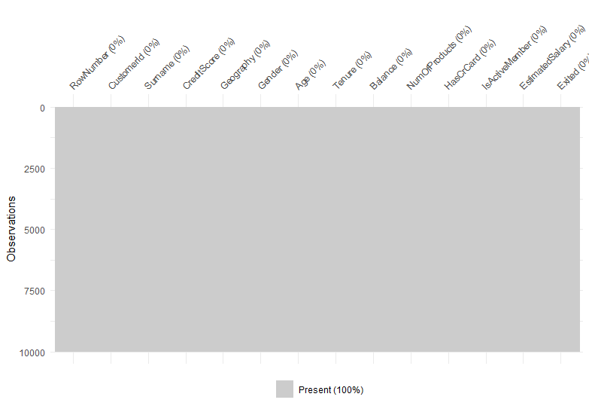
Background
Data obtained from kaggle website
14 variables
Target variable is a binary variable reflecting the fact that customer left or stay with the bank
Privacy issues: surname in the data. Real name?
Geographical limitation: France, Germany, Spain
Vis_miss: all gray indicates no missing data

Slide 3
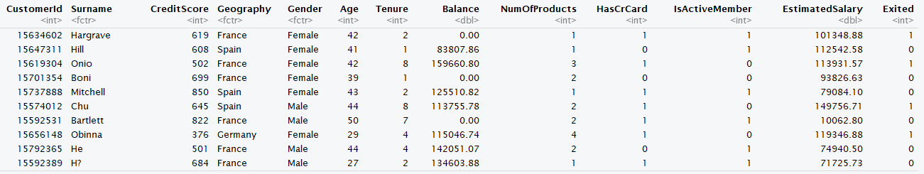
Data Cleaning
Data pre cleaning

Slide 4

Data Cleaning Continued
Used the R function Dplyr to clean columns and reclassified variables
Removed columns based on data exploration, and from data integrity issues

Slide 5
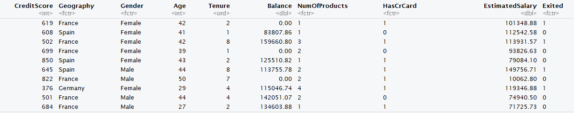
Data Cleaning Continued
Data fully cleaned

Slide 6
Data Exploration
Changed the columns to appropriate datatypes
Created AgeBins column using the Age column ranging from 17 through 105 in intervals of 10
Created CreditScoreBins column using credit scores ranging from 400 through 850 in intervals of 50
Created EstimatedSalaryBins column using Estimated Salary ranging from 0 through 200000 in intervals of 20000
Converted the Tenure column into a factor with the ordered levels 0 through 10

Slide 7
Data Exploration continued
Customer Tenure
Age
Gender
Credit Score
Location
Other

Slide 8
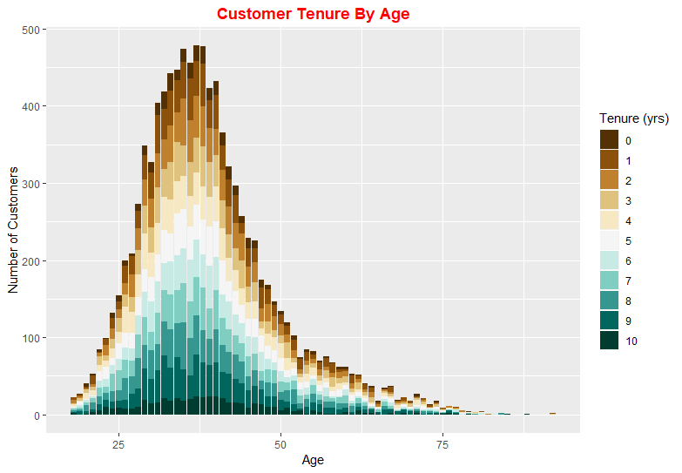
Data Exploration
The majority of customers have been with the bank for at least 5 years
Majority of customers are 25 to 50 years of age

Slide 9
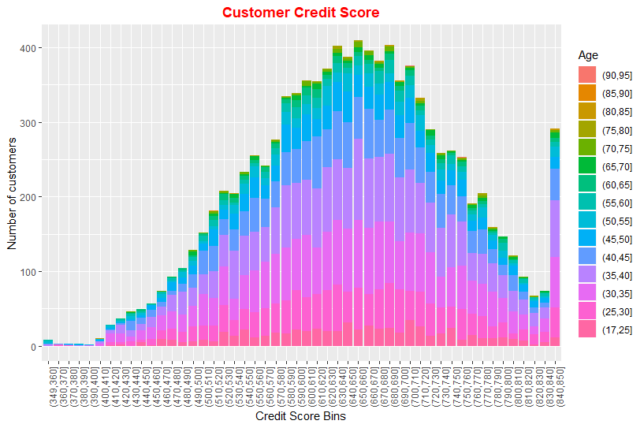
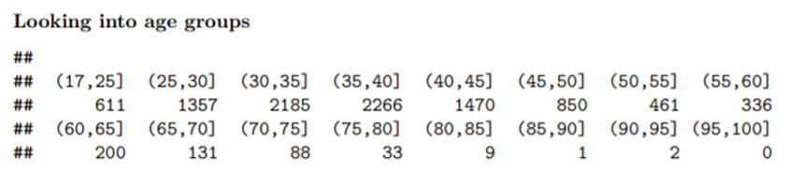
Analysis by Age

Slide 10
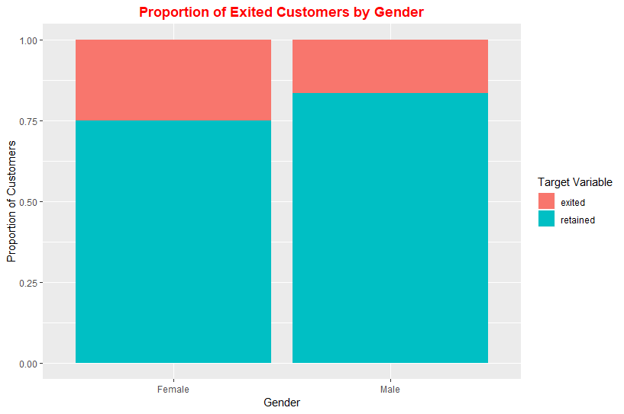
Analysis by Gender
25 percent of female exited
14 percent of male exited
Males account for 55% of the data

Slide 11
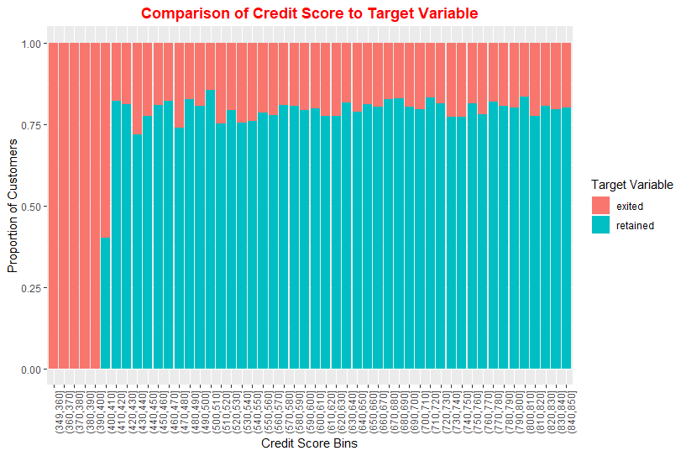
Analysis by Credit Score
Credit score lower than 390 exited the bank
Approximately less than 25% of customers exited for all credit score
Credit score does not seem to have a considerable impact

Slide 12
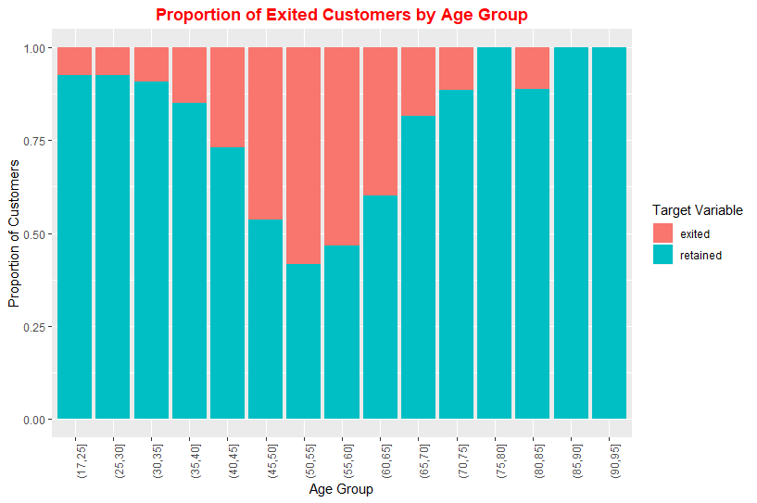
Analysis by Target Variable
Increase exit rate by age until maximum rate at age between 50 and 55
Decrease after 55
Ages 50 to 60 have the highest customer exit rate, more than 50%
Outlier between ages 80 and 85

Slide 13

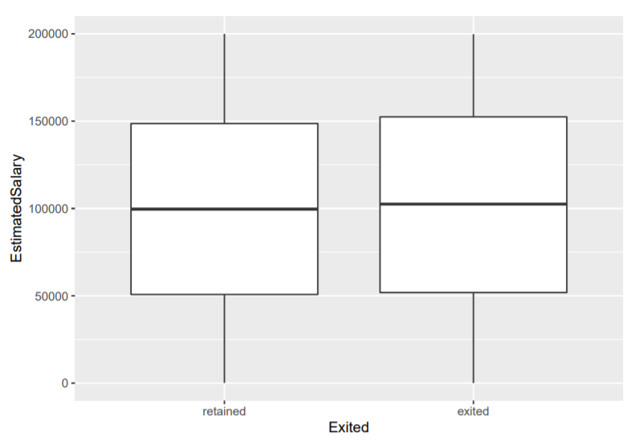


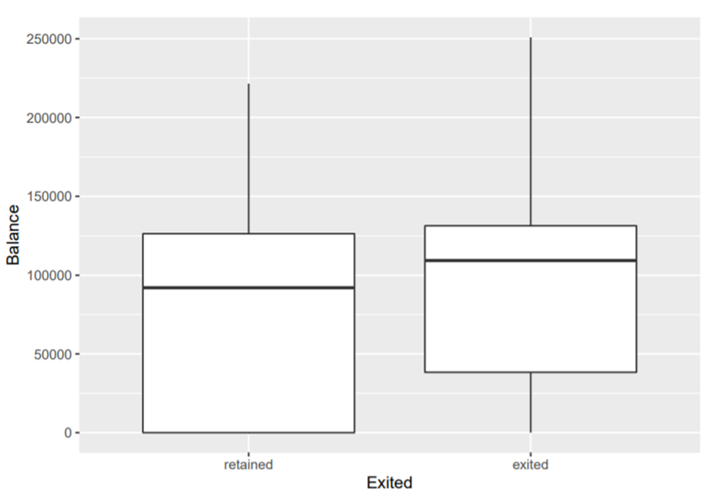

Analysis by Balance and Estimated Salary
The median estimated salary of the customers who have exited the bank seems to be similar to the median estimated salary of the customers who have been retained
However, the median Balance held by the customers who have exited the bank seems to be higher than the median balance held by the customers who have been retained

Slide 14
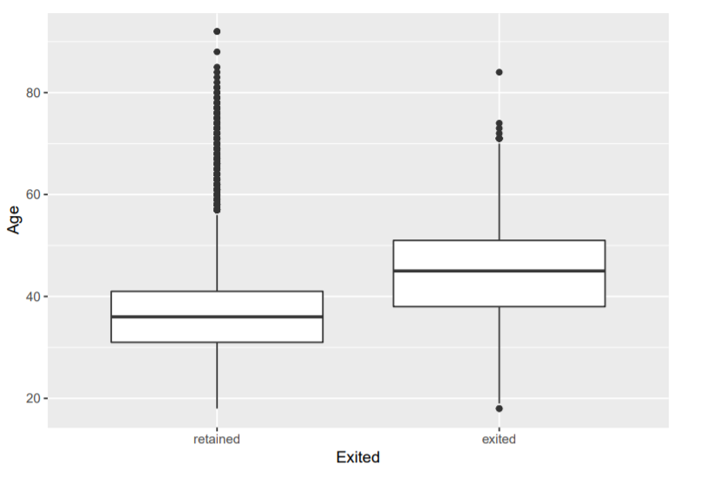
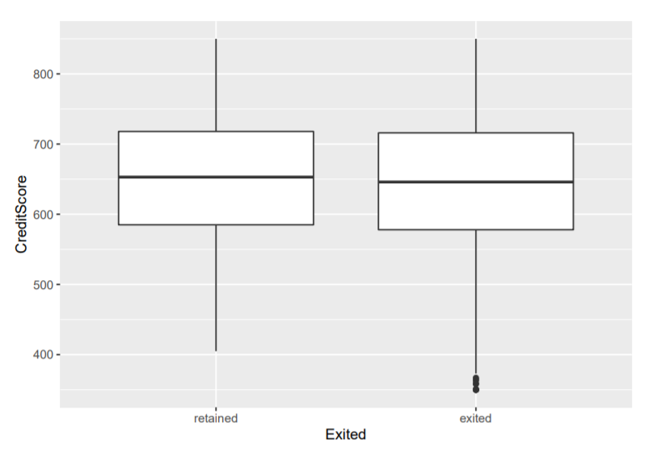
Analysis by Age and Credit Score
The median age of the customers that are retained are much lower than the median age of the customers that have exited the bank
There also seems to be a lot of outliers in the age of the people who are retained
However, the median credit score of the customers who have exited the bank seems to be similar to the median credit score of the customers who have been retained

Slide 15
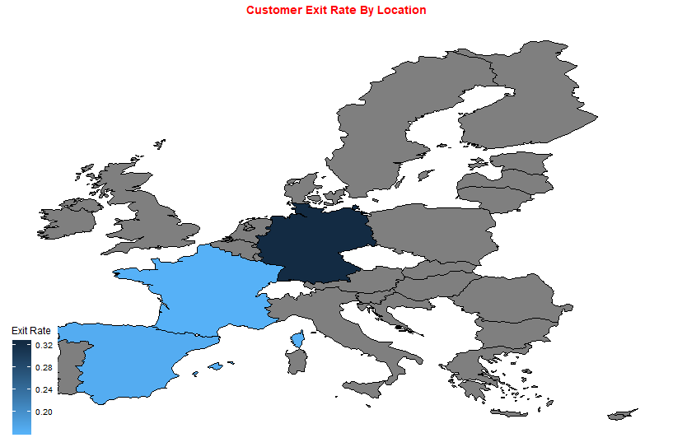
Analysis by Location
The darker the higher exit rate
Germany has the highest exit rate
Spain and France have exit rate less than 0.20

Slide 16
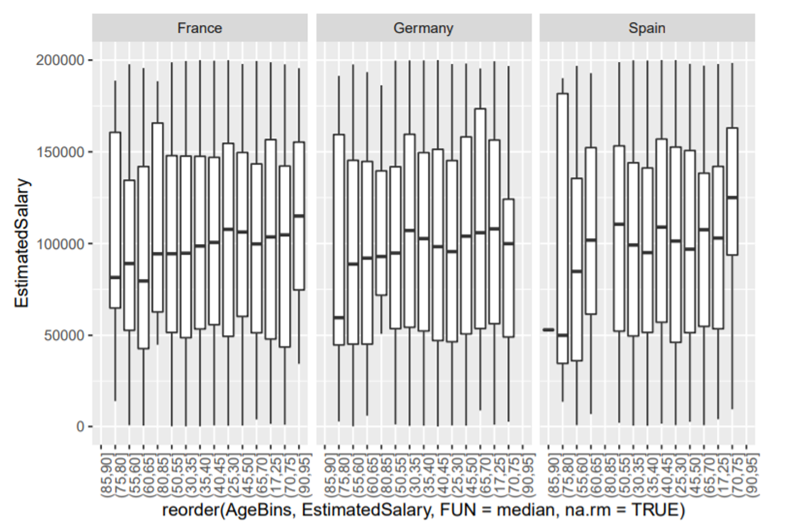
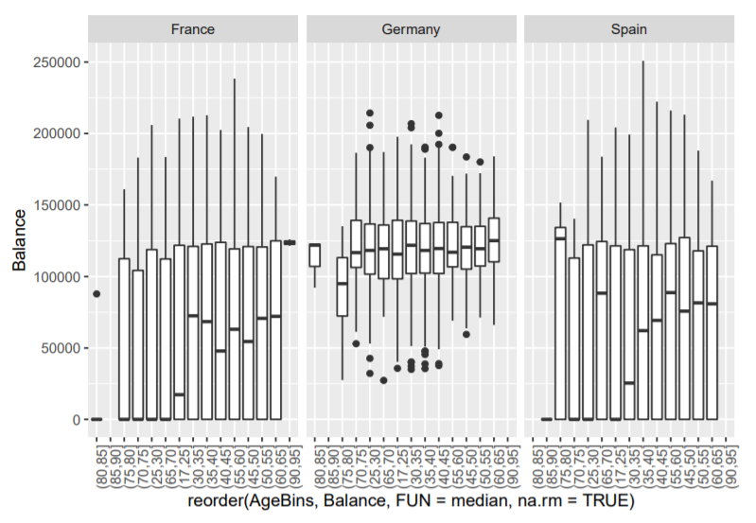
Analysis of Estimated Salary and Balance by Location
The Estimated Salary of all the three countries seem to have similar spread of customers
However, the Balance held by the customers in Germany seem to be concentrated between 100,000 to 150,000 with a lot of outliers among different age groups as compared to the other two countries

Slide 17
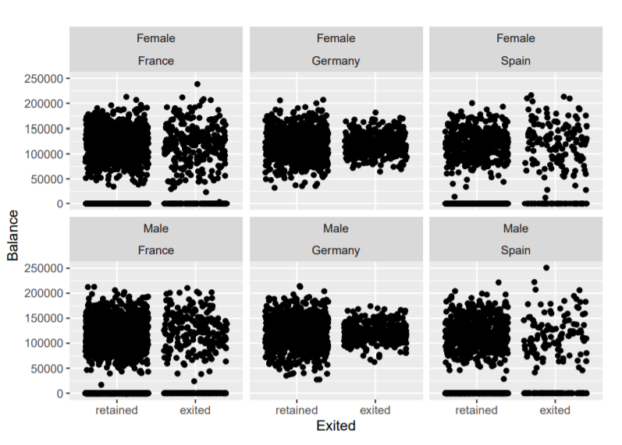
Analysis of Balance by Gender and Location
Germany seems to stand out from the other two countries with respect to the people who have exited
Most of the people in Germany across Genders who have Exited seem to have a Balance clustered near 100,000 and 150,000 as opposed to the other two countries that have a better spread

Slide 18
Data Modeling
Normalized numeric features
(centered and scaled)
Created dummy variables for categorical features
Holdout set to verify model performance(70%/30% split)
Oversampled the training set
Class imbalance in total data set: 7,963 retained vs 2,037 exited
Randomly oversampled instances of the ‘exited’ class until training set was split 50/50

Slide 19
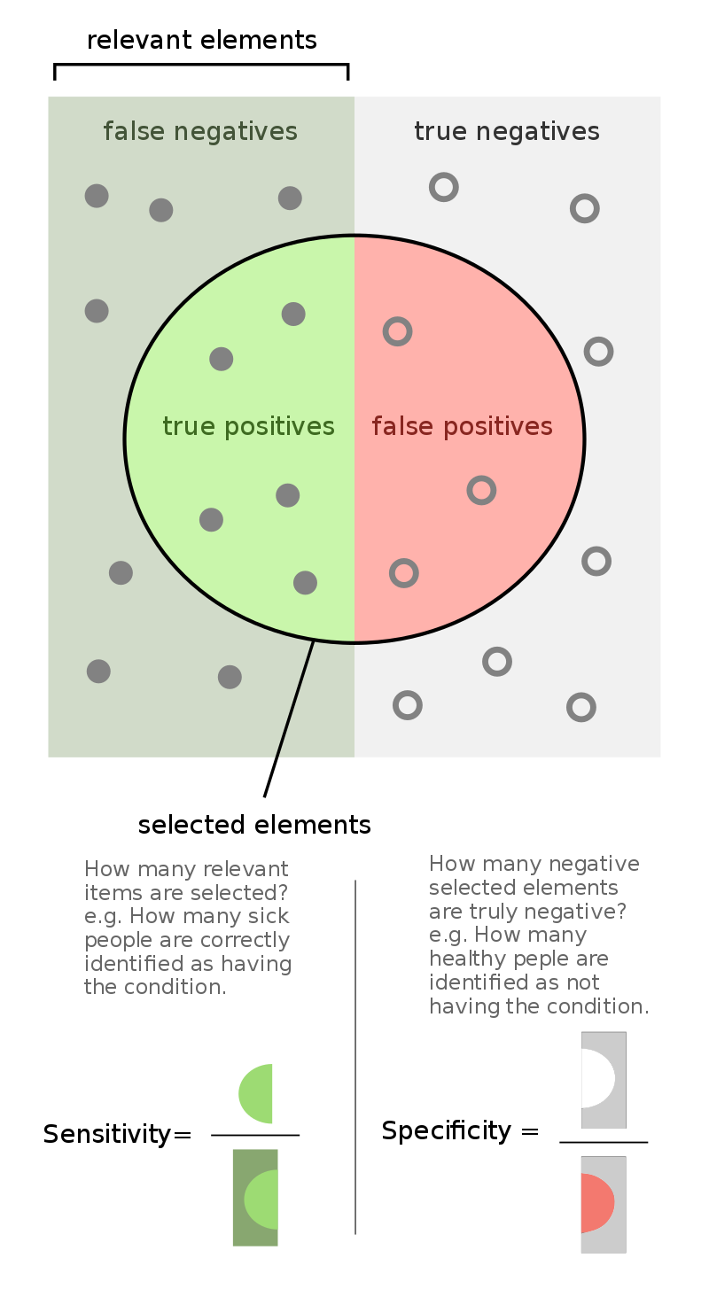
Model Evaluation
Business goal: predict exiting customers so that the bank can entice them to stay with offers/rebates/etc.
Minimize False Negative rate (1-Sensitivity)
So indirectly, maximize Sensitivity
Total Model Accuracy
https://en.wikipedia.org/wiki/Sensitivity_and_specificity

Slide 20
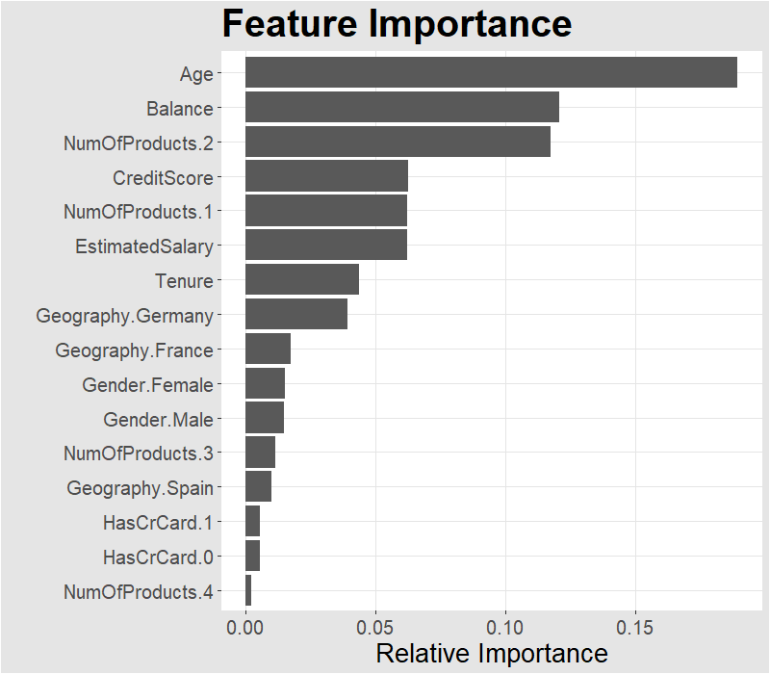
Feature Importance
Age, Balance, and Number of Products == 2 were identified in data exploration strong predictors
randomForestSRC_importance ranking method

Slide 21
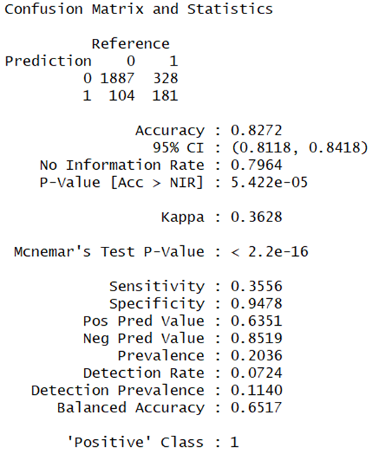
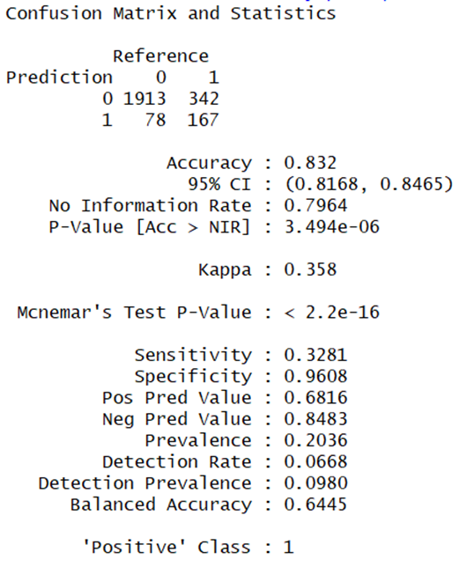
Base Models
Naïve Bayes
Logistic Regression

Slide 22
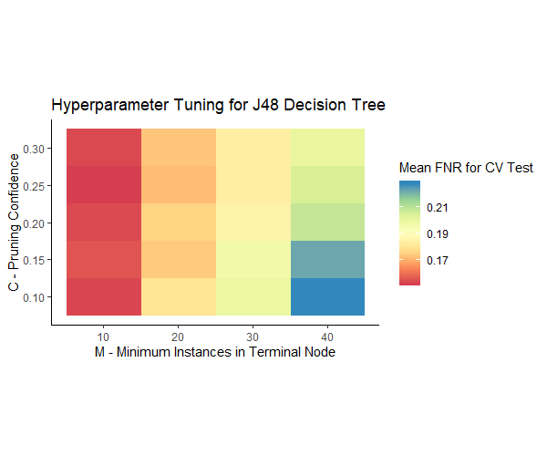
J48 Decision Tree Model

Slide 23
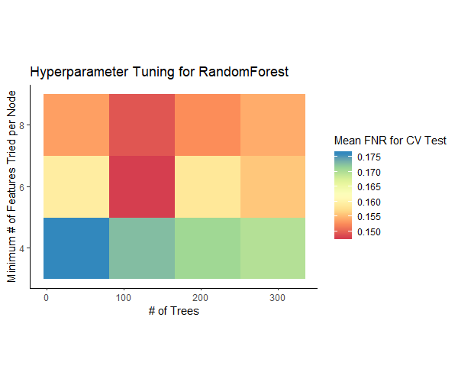
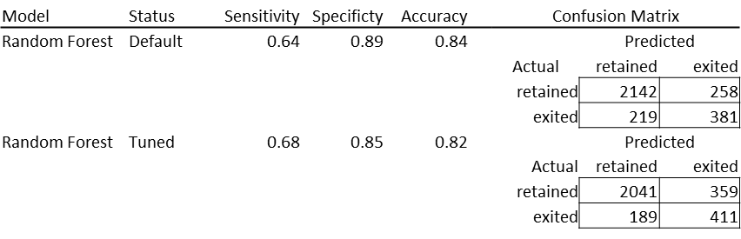
Random Forest Model

Slide 24
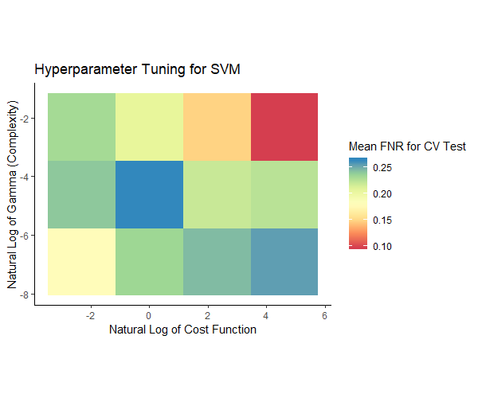
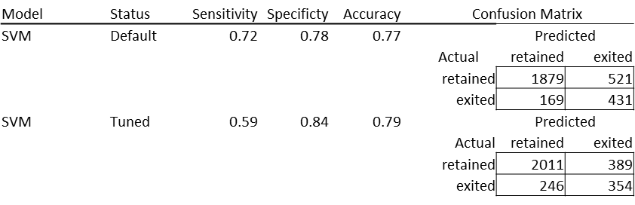
Support Vector Machine (SVM) Model

Slide 25
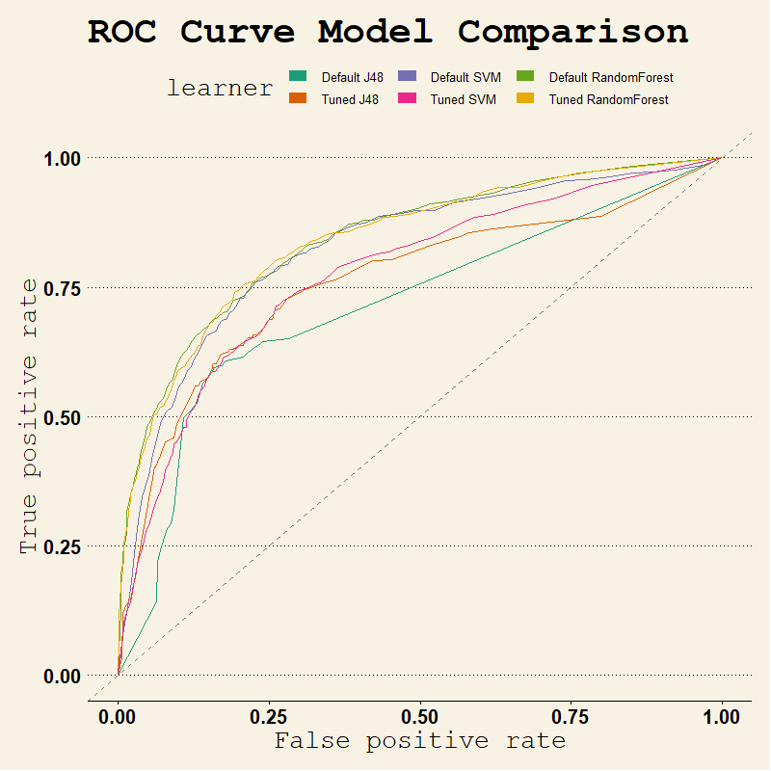
Model Comparison

Slide 26
Conclusion
The bank has some of its most success with customers that are 30 to 40
Other important factors were the amount of products one has with the bank and their balance
Based off our models we would recommend using the Random Forest model for accuracy but when avoiding false positives one should use our first SVM model

